Slide 1
ENSE 374, Milestone 3
The Great Value
Azeezat, Krupal, Joseph, Clark, Martha
October 30, 2018

Slide 2
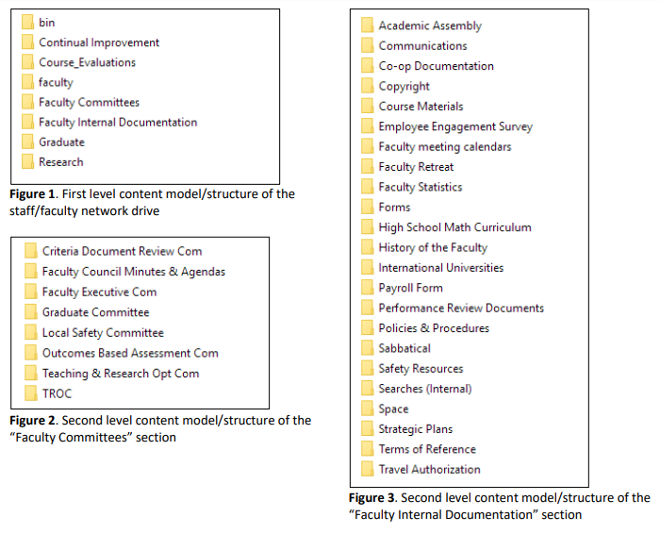
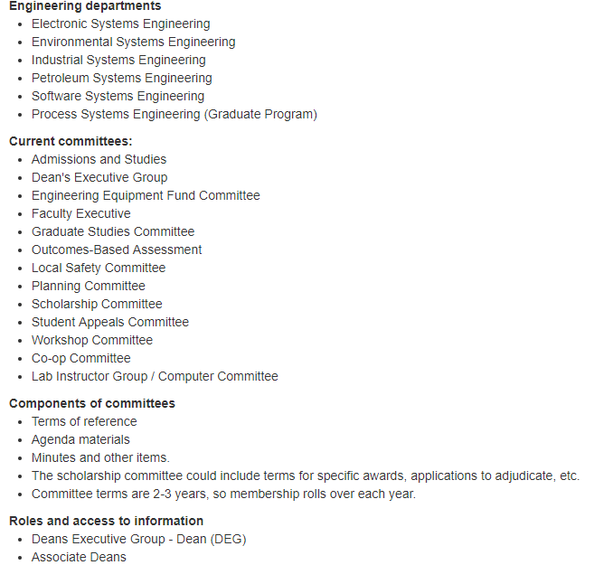

Slide 3
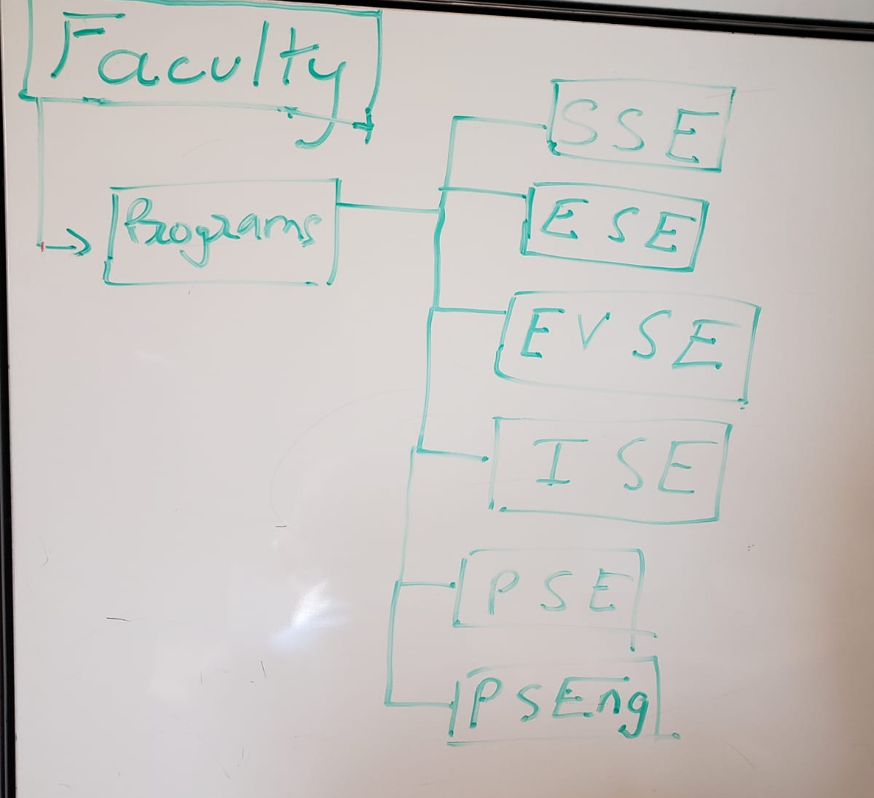
Faculty
?
First try

Slide 4
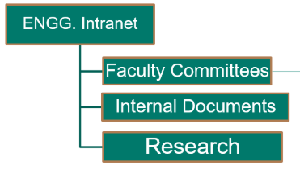
Internal Documents

Slide 5
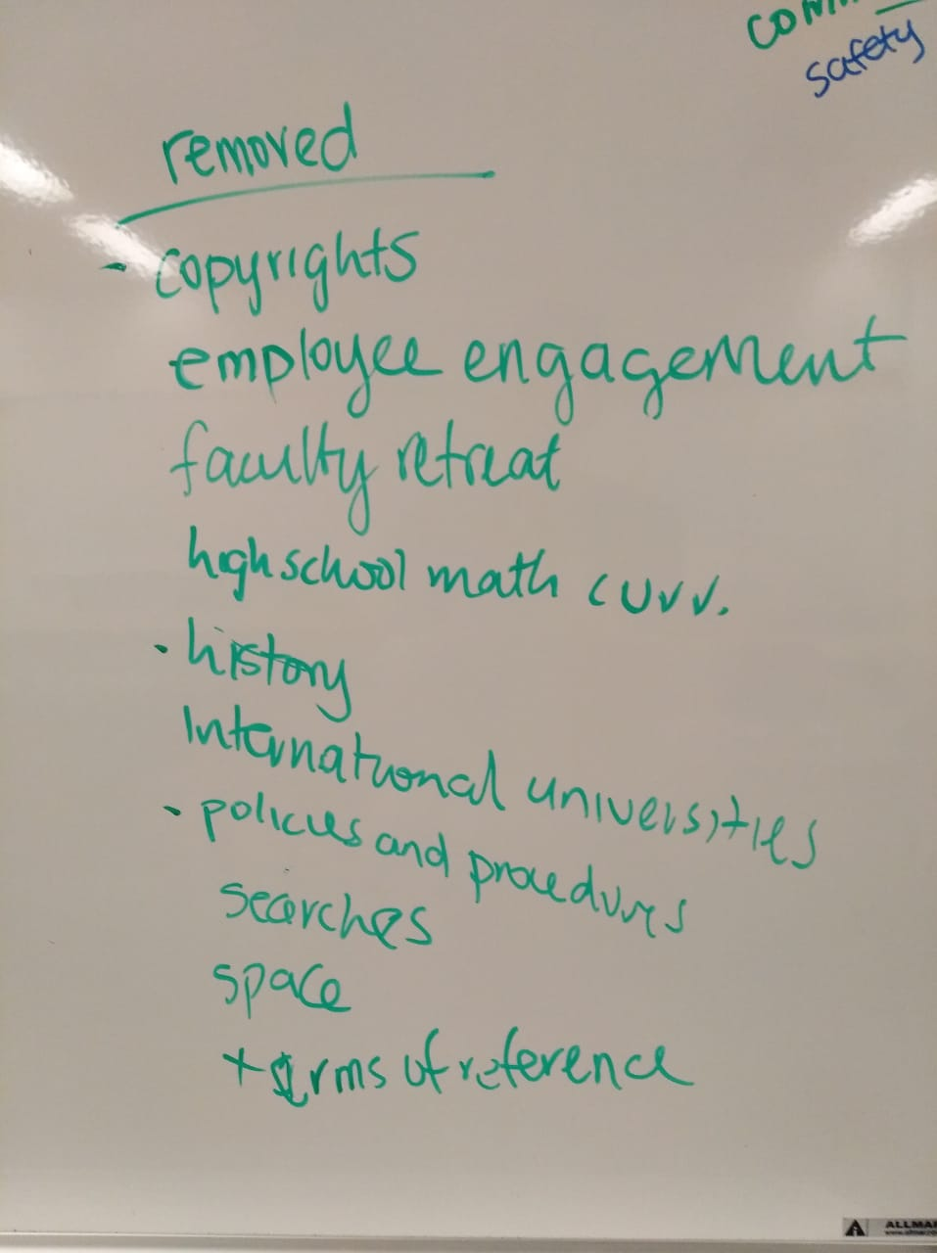

Slide 6
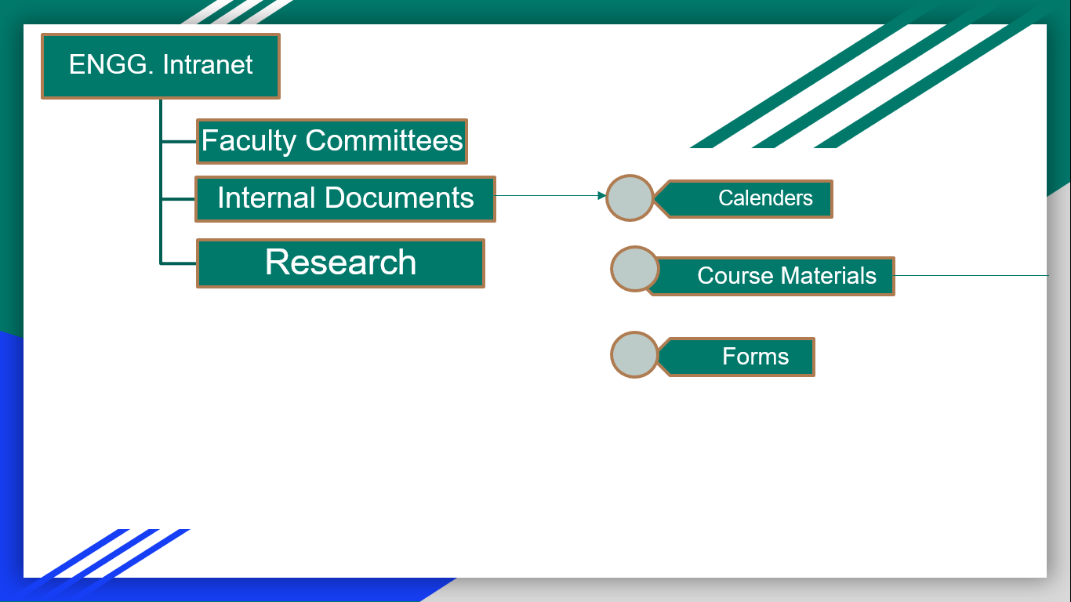

Slide 7
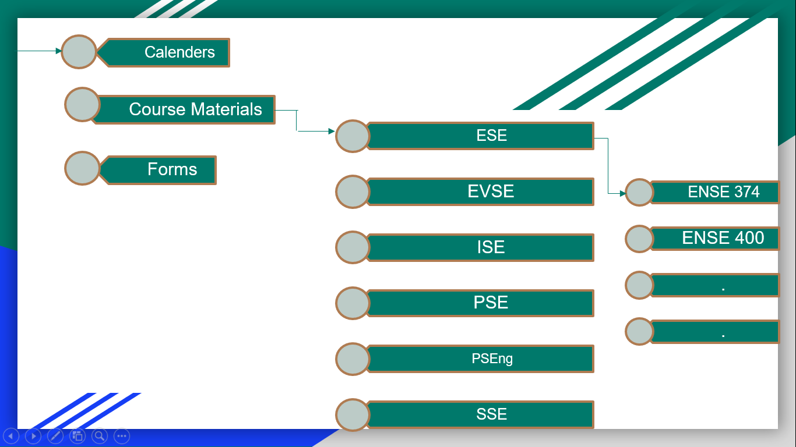

Slide 8
Security: Internal Documents
Calendars: access by everyone as it is a calendar of events happening in the engineering faculty
Course Materials: should be accessed by faculty, faculty executives and deans
Forms: access by everyone

Slide 9
Committees

Slide 10
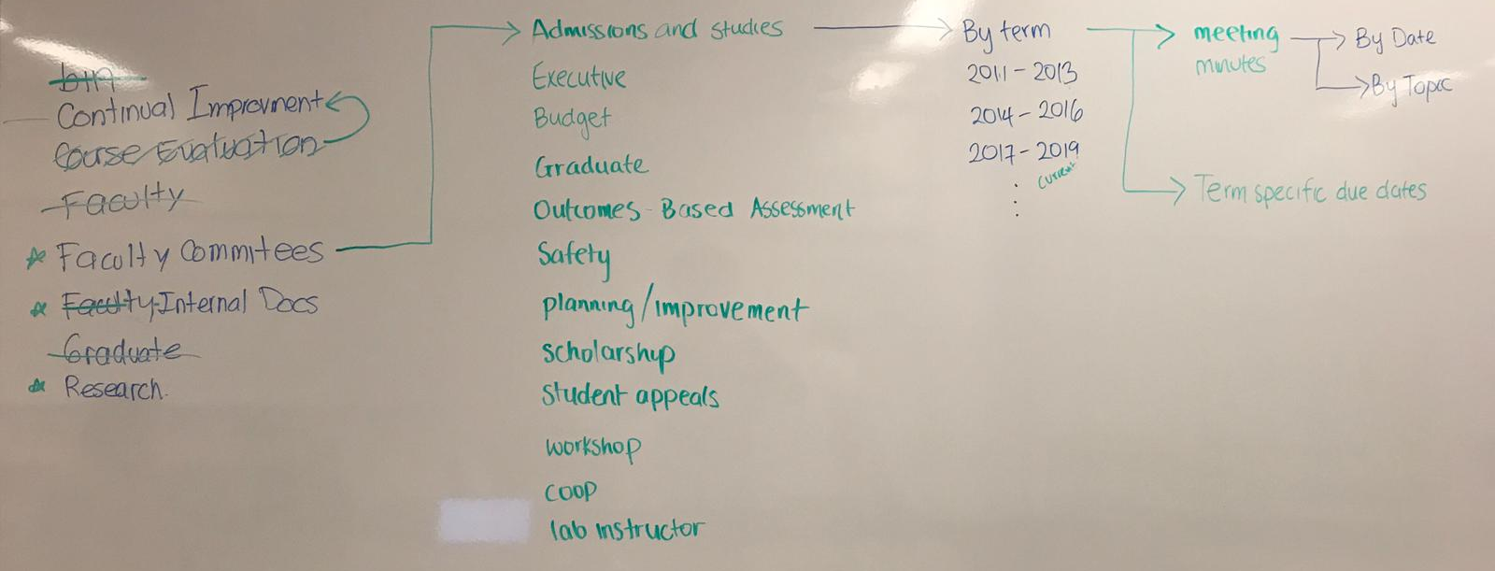

Slide 11
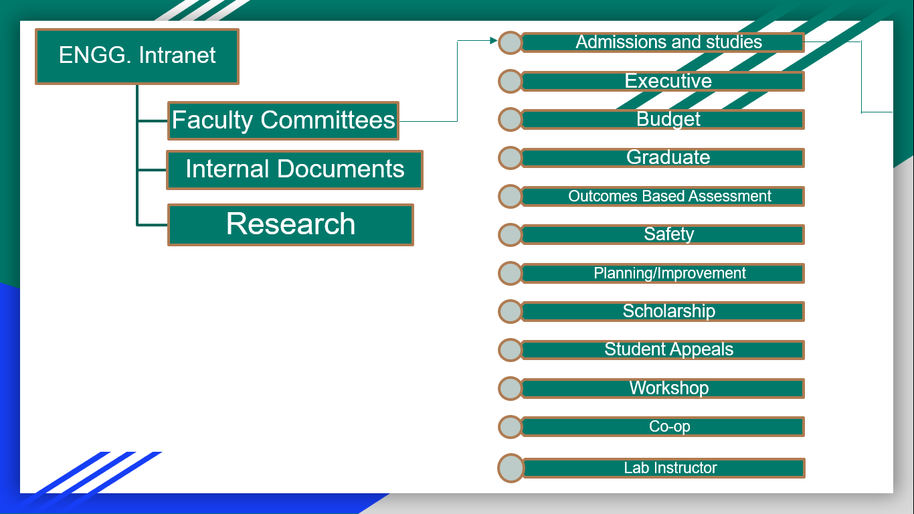

Slide 12
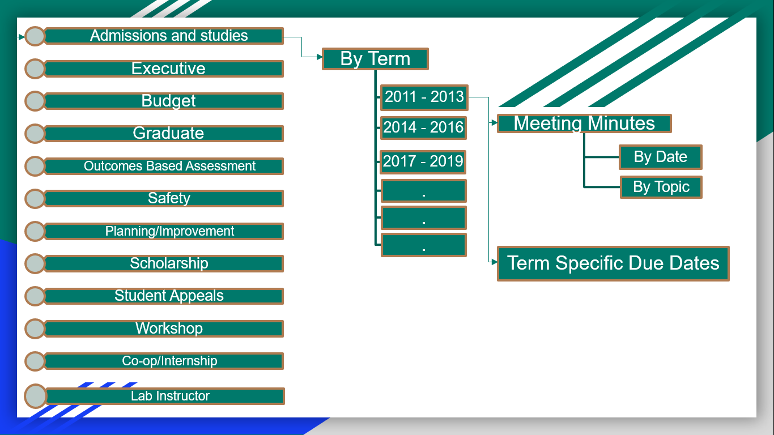

Slide 13
Security: Faculty Committee
For security purposes, only the members of the committee should be able to access the folder.

Slide 14
Research

Slide 15
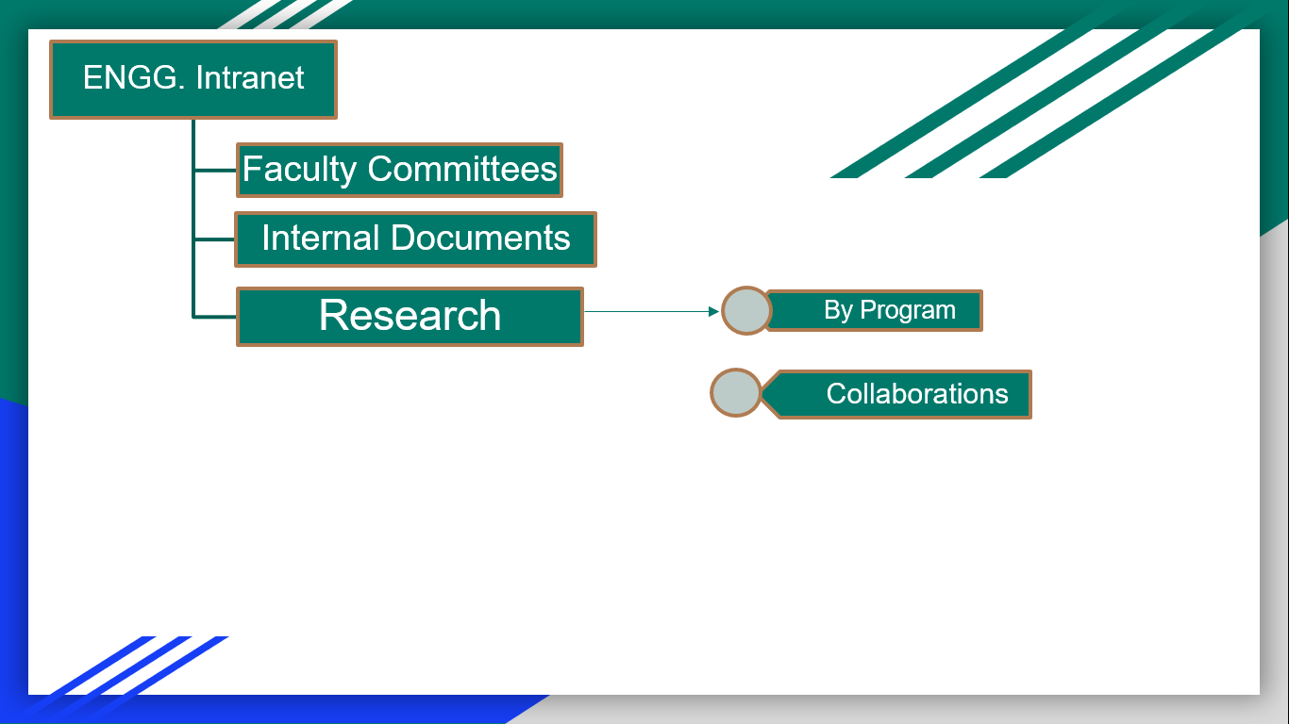
Research

Slide 16
Security: Research
Assuming all the research posted on the engineering intranet is already published, anyone can access the information; otherwise only the professor carrying out the research should be able to access the files

Slide 17
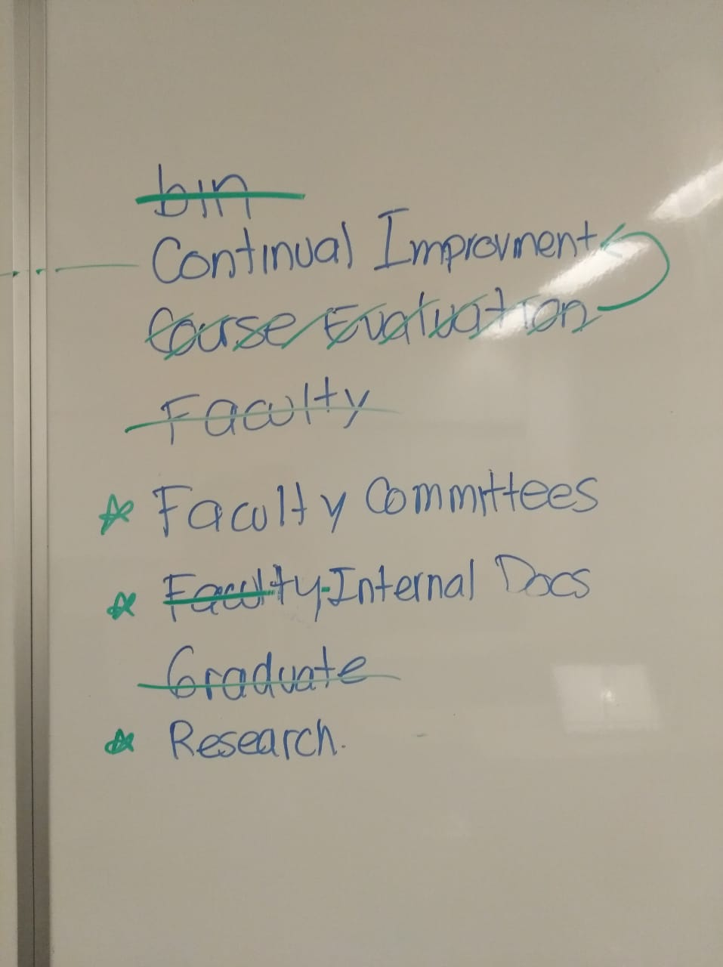
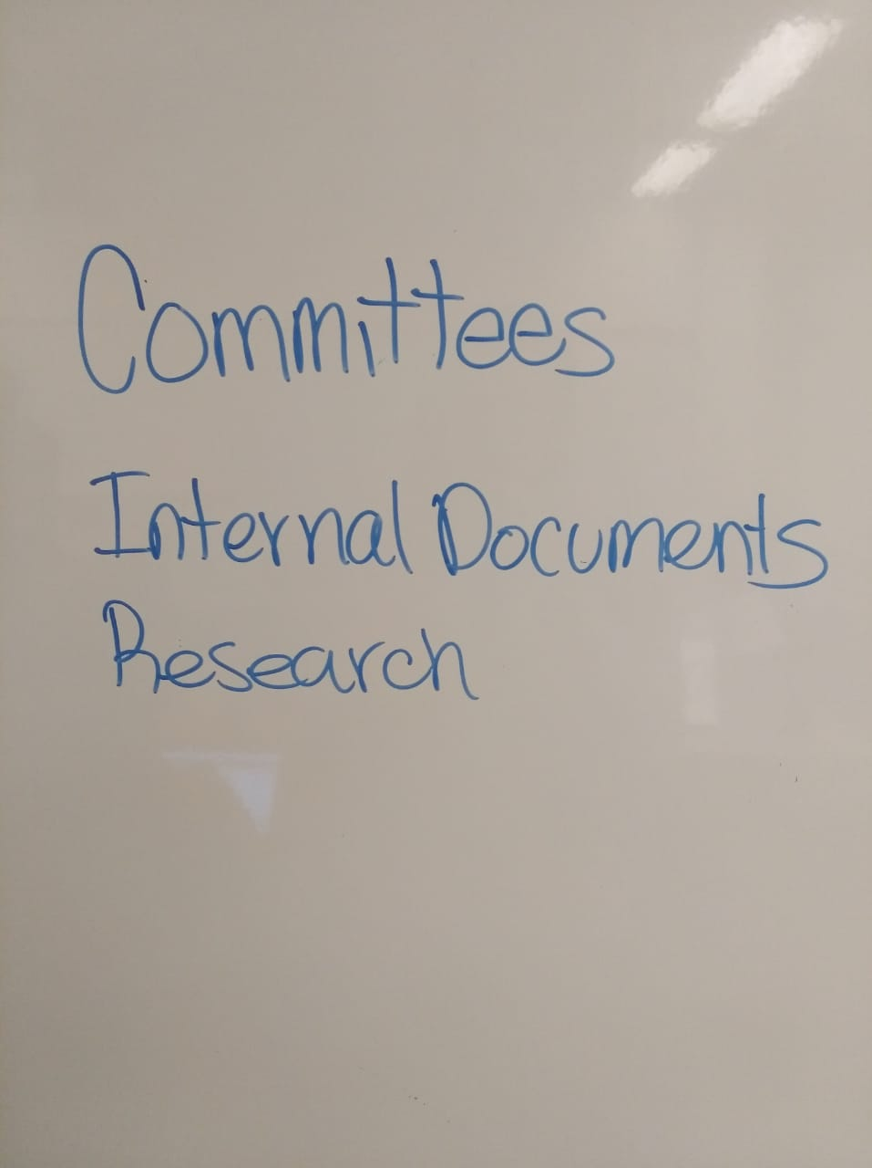
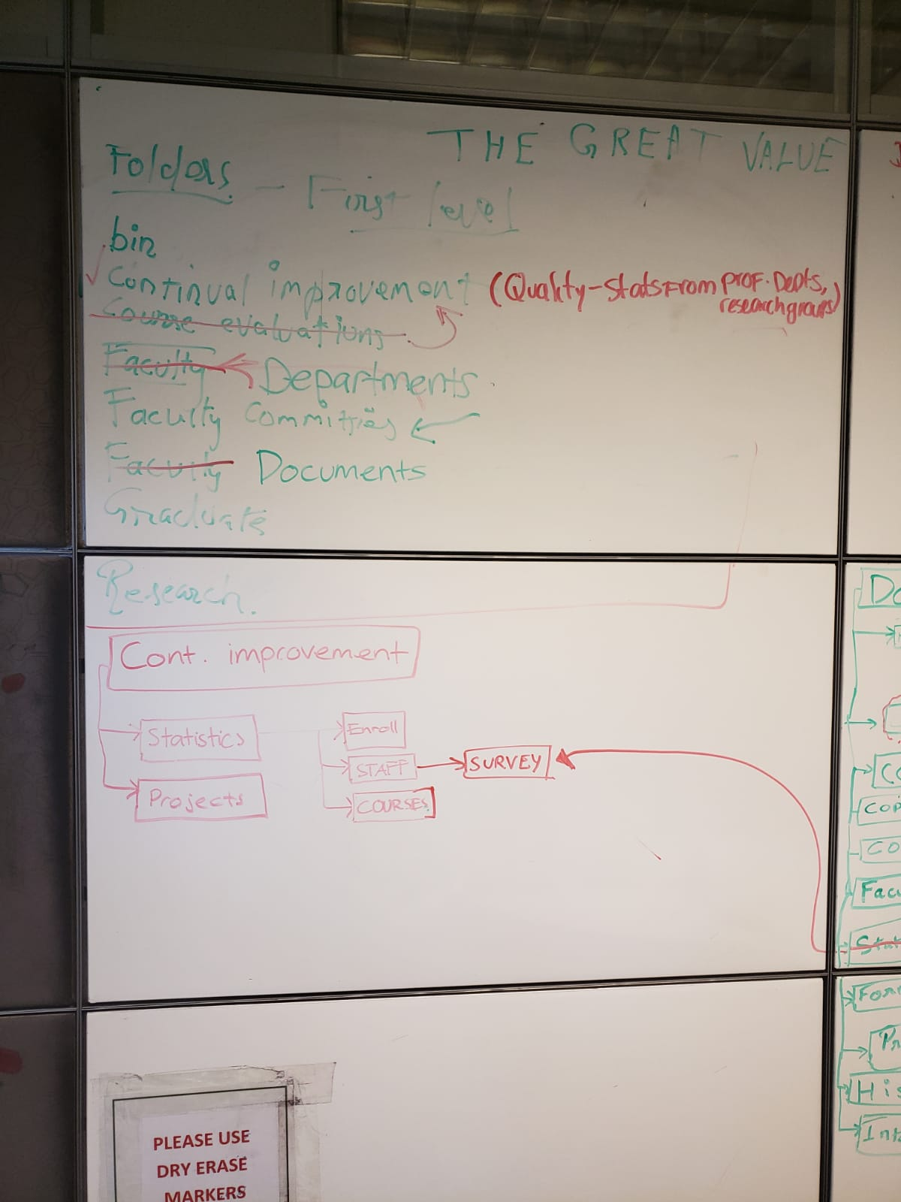

Slide 18

Group Reflection
About this milestone:
We were able to efficiently work together as a group to create the content strategy. We were able to confirm the quality and correct focus of the work.
About ourselves:
We were able to work better because we asked for clarification on what we didn’t understand about the milestone. This helped us a lot.
In the future:
We will continue to ask for clarification as this is better than being confused and doing the wrong thing.
Help needed?
We had a lot of questions for this milestone and we were able to get answers to them.
Image taken from: http://homeschoolcpa.com/board-turnover-may-mean-the-purpose-of-the-homeschool-group-could-change/
Notes:
How did you feel about this milestone? What did you like about it? What did you dislike?
What did you learn about yourselves as you collaborated and worked through this milestone?
How will you use what you have learned going forward?
What “stuff & things” related to this milestone would you want help with?

Slide 19
Questions?

